Slide 1
Issue: The neural network does not learn
By: Steven Cao

Slide 2
Things to Note
The Heart.dat dataset is another dataset online which I used to compare with the ecg dataset.
Although the MIT-BIH dataset contains 5 classes, I turned it into a binary classification problem, by replacing all the 2, 3, and 4’s into 1s. I wanted to first create a neural network for binary classification first before converting into multi-class classification
My neural network is a two-layered neural network and not a three-layered neural network, just so I am understand the mechanics of each part of the neural network.

Slide 3
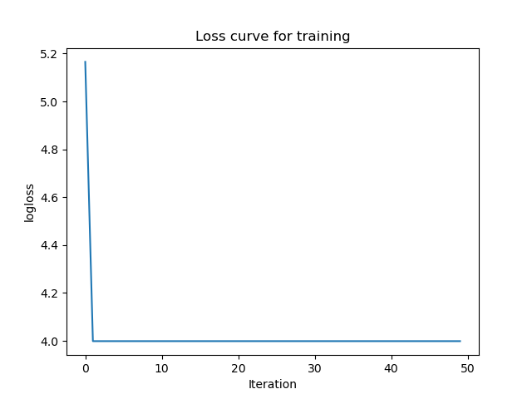
Problem: issue of not learning
1st iteration using random weights and bias
2nd - 100th iteration
accuracy: 0.26002284408909193
precision 0.18436465495289026
recall 0.9523183163433081
[[ 1657 12812]
[ 145 2896]]
accuracy: 0.8263278126784694
precision 0.0
recall 0.0
[[14469 0]
[ 3041 0]]
Initialized different weights and bias, and each did start with different accuracies, but it all stayed the same after the 2nd iteration
Conclusion: Something must be wrong with the backpropagation updating the weights.

Slide 4
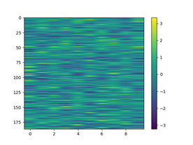
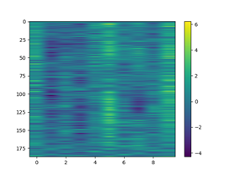


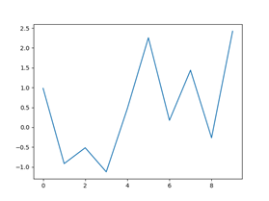
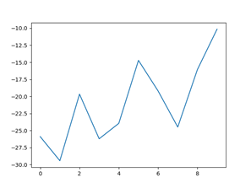

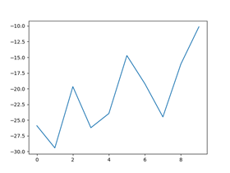
Lets see how the weights change over each iteration
Weights for 1st layer
Weights for 2nd layer
1st iteration
2nd iteration
3rd iteration
4th iteration
Conclusion: The weights do not change at all after the 2nd iteration.

Slide 5
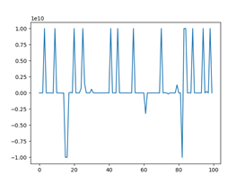
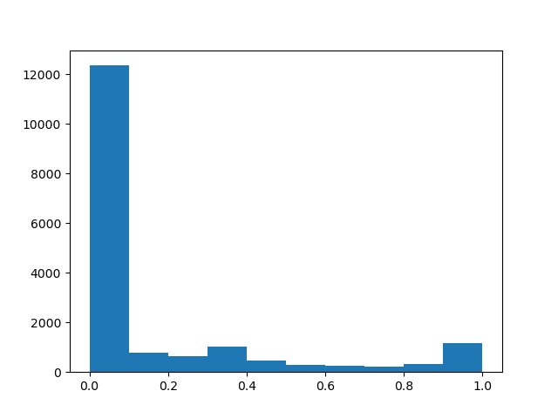
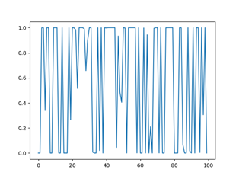
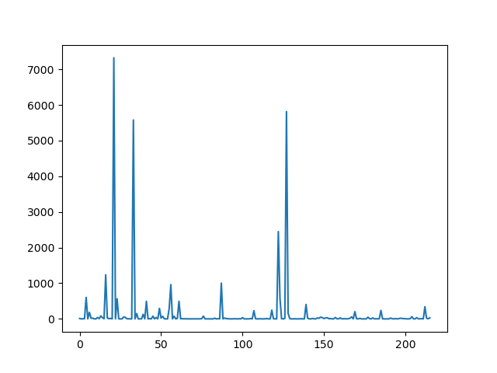
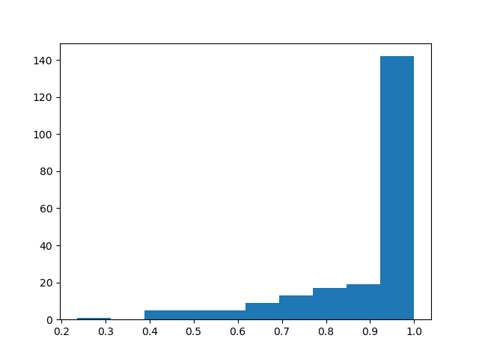
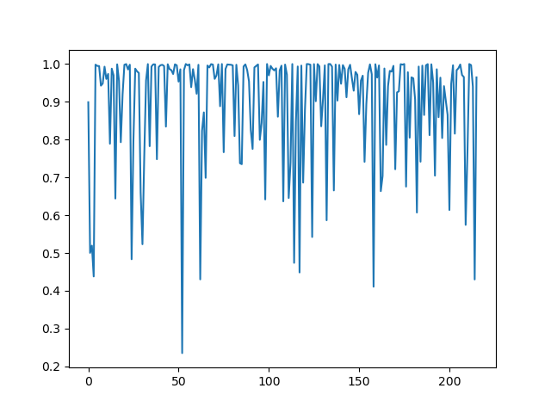
Checking Backpropagation by first plotting the dl_wrt_yhat, since it all starts here
ECG Dataset
What we have now
Heart.dat Dataset
What it should look like
dl_wrt_yhat
yhat
Distributions of yhat
Conclusion: The yhat values are either close to 0 or 1, which is not what you want. The dl_wrt_yhat contains values that are out of bounds and is incorrect.
On the other hand, the yhat values for the heart.dat neural network are relatively distributed from 0 to 1.

Slide 6
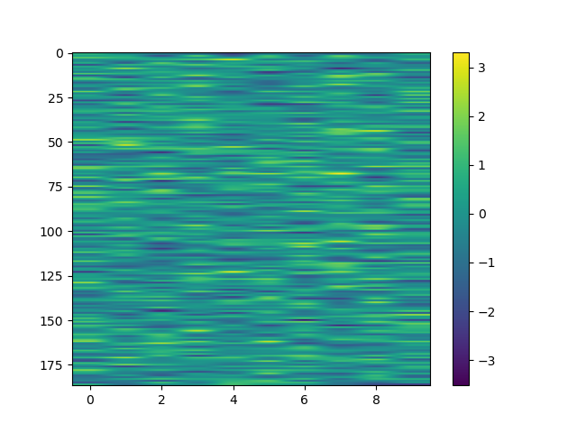
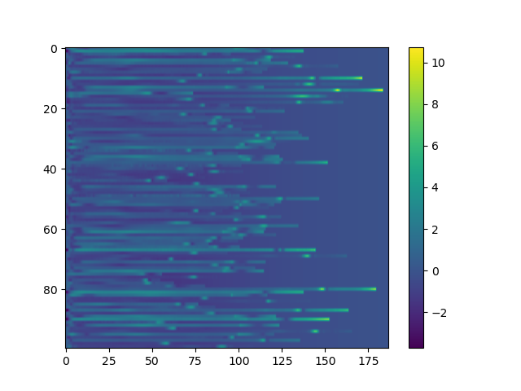
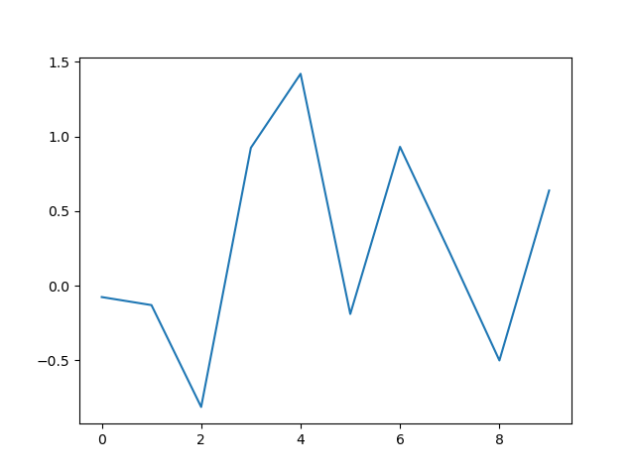
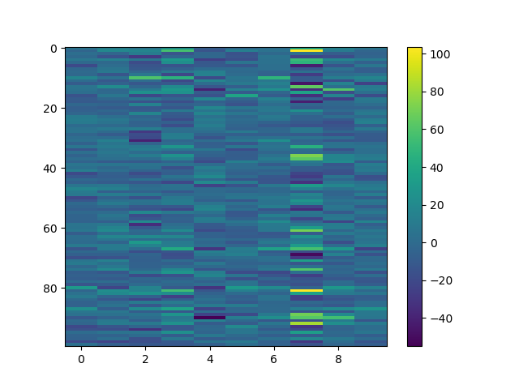
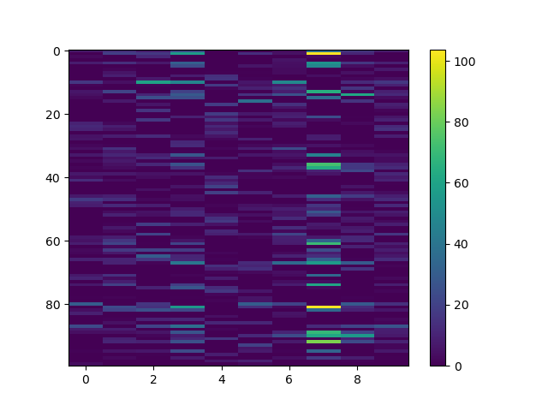
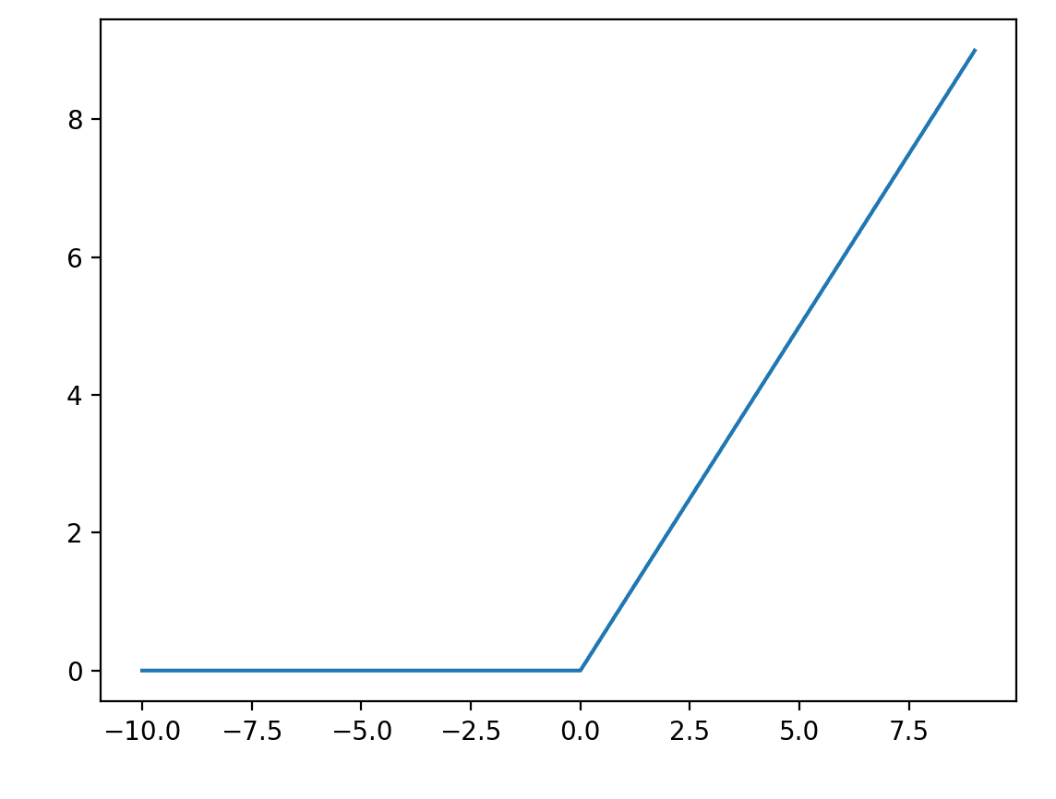
We need to go look at the forward function to see why the yhat values are either close to 0 or 1
X
+
=
Weights 1
X_train
Bias 1
Z1
After applying relu
Z1
A1

Slide 7
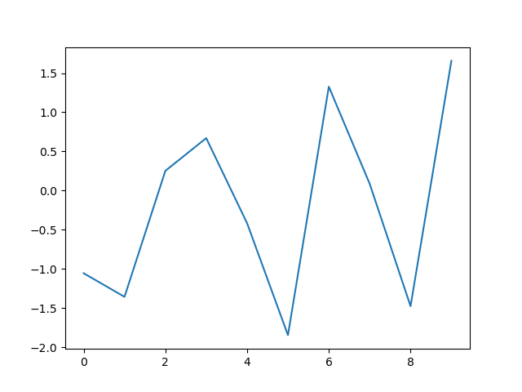
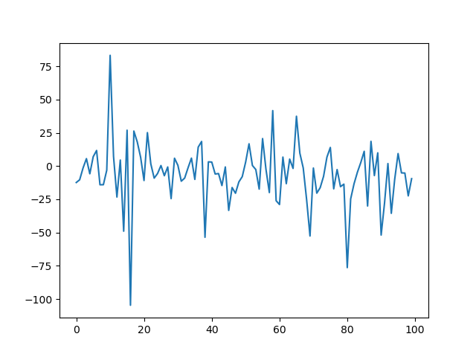
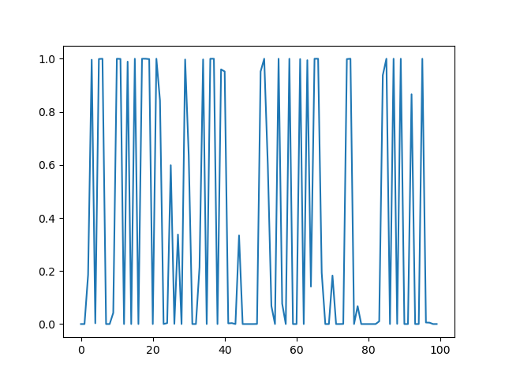
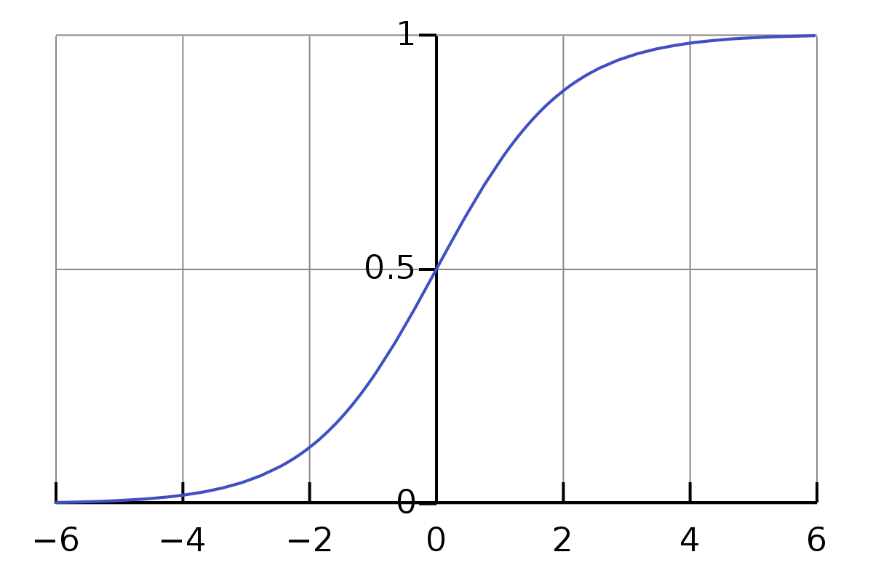
Looking at the second layer and how it results in making the yhat values go either close to 0 or 1
-1.82998495
=
X
Weights 2
Bias 2
Z2
A1
After applying sigmoid
Z2
yhat

Slide 8
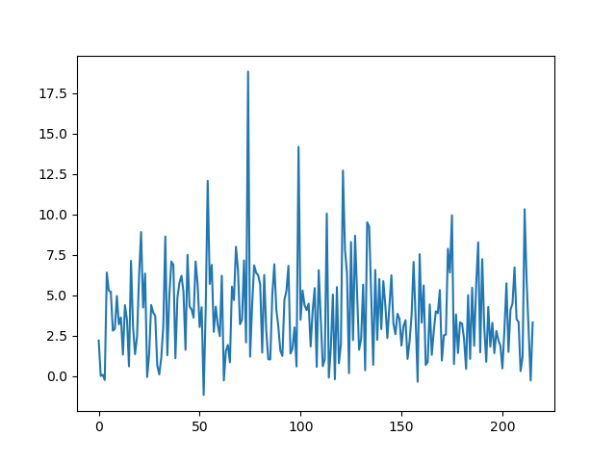
Conclusion: the reason why the yhat values are close to 0 or 1 is because the sigmoid function does not do well with values that are greater than 4 or less than -4
Heart.dat dataset (Z2)
ECG dataset (Z2)
And so when you use the sigmoid function, it makes all those values turn into values like 0.99999 or 0.00001
Sigmoid Function

Slide 9
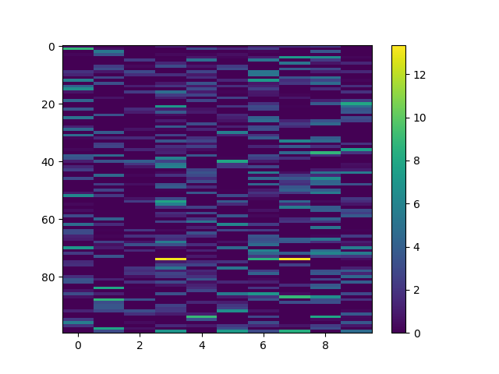
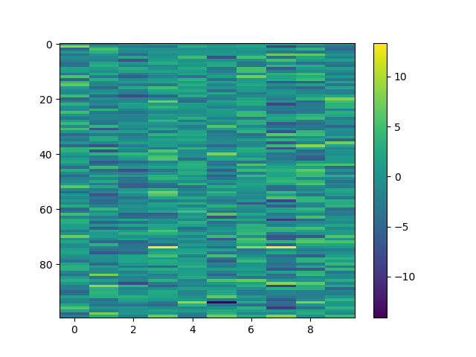
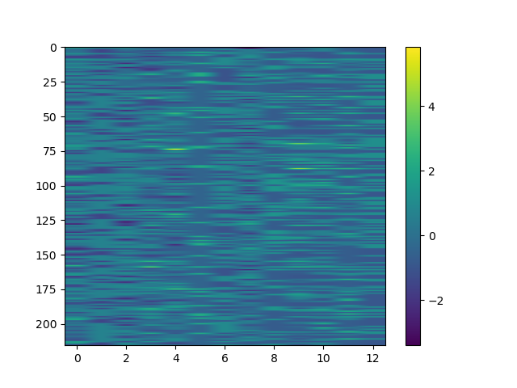
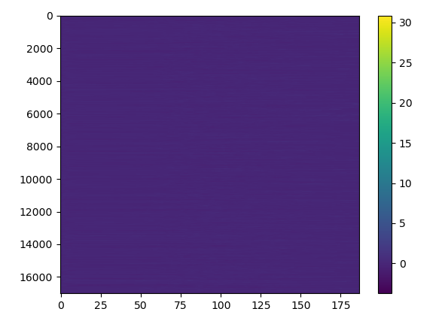
Why the Z1 values are like that?
Conclusion: The ECG dataset has higher values than the heart.dat dataset. We need to normalize the ECG dataset
A1
Z1
X_train
Heart.dat dataset
ECG dataset

Slide 10
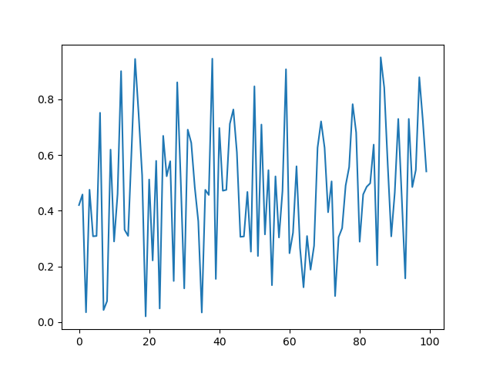
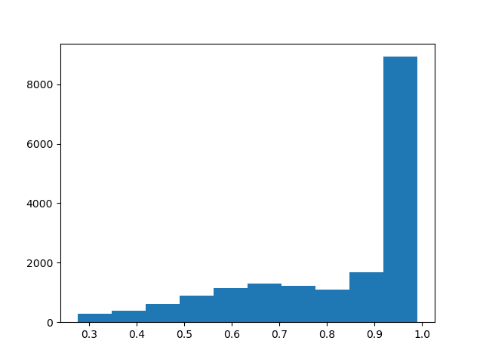
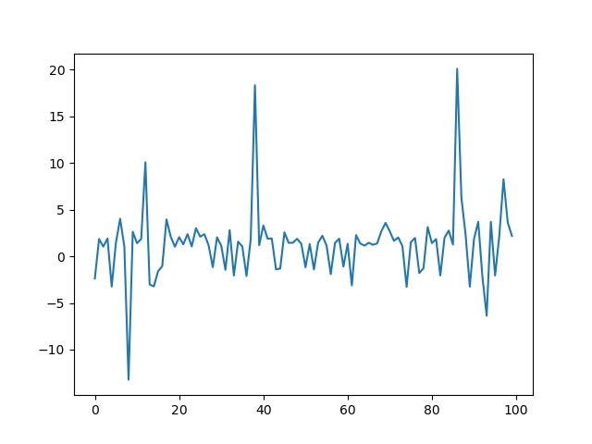
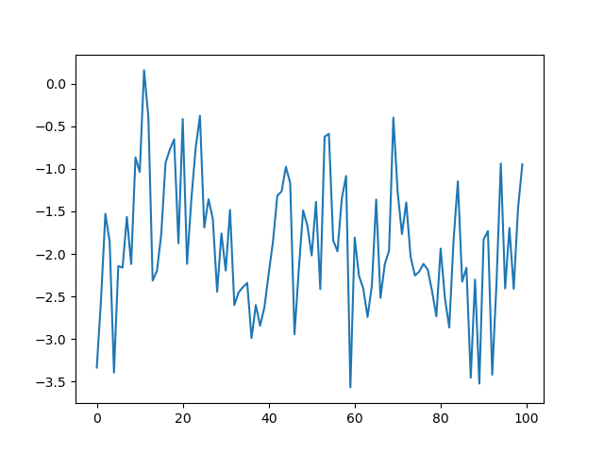
Changing the relu activation function to sigmoid
We changed from relu to sigmoid for the first layer, because it will first make sure that the huge values like 100 will be compressed to 1 so that it will not cause 0.99999 s and 0.000001s after the sigmoid in the second layer.
yhat(first 100 samples)
Distribution of yhat
dl_wrt_yhat(first 100 samples
Z2(first 100 samples)

Slide 11
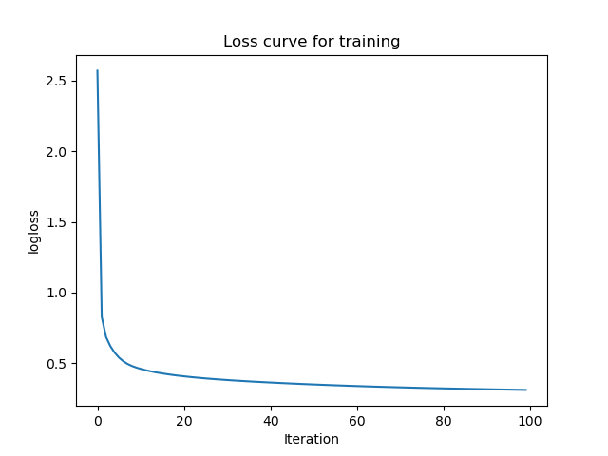
1st iteration using random weights and bias
100th iteration
accuracy: 0.22381496287835523
precision 0.13459407037960655
recall 0.6389345609996712
[[ 1976 12493]
[ 1098 1943]]
accuracy: 0.8932038834951457
precision 0.8106100795755968
recall 0.5024662939822426
[[14112 357]
[ 1513 1528]]
Conclusion: It learned :)

Slide 12
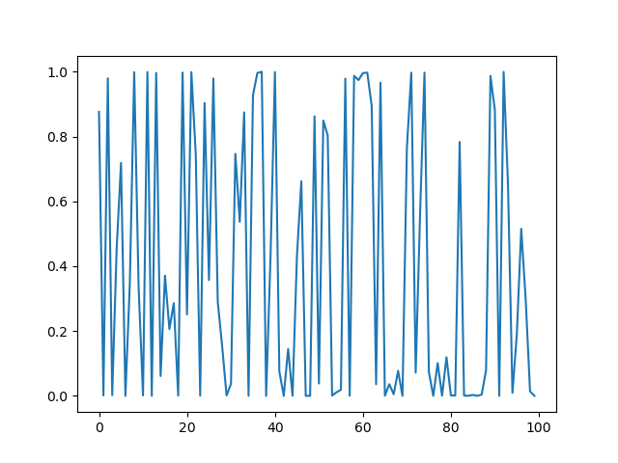
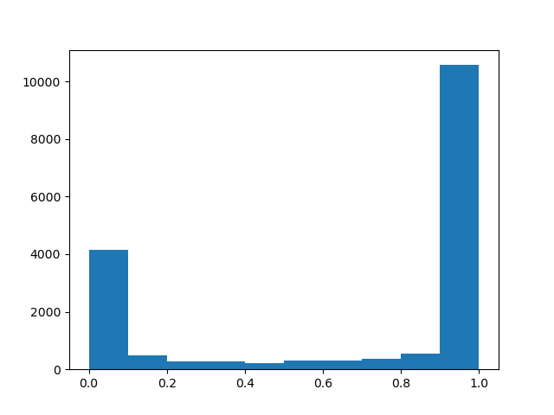
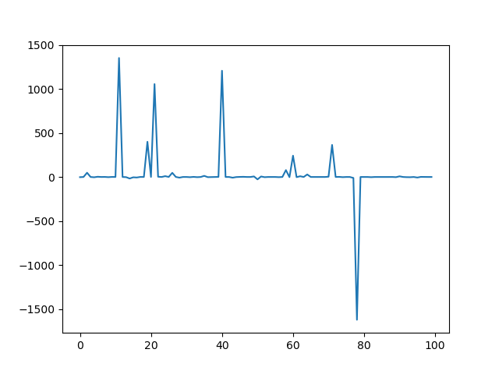
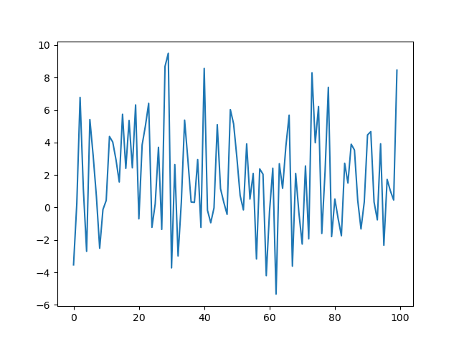
I also tried relu6 to see that if we have a cap, would it solve the problem of the model not learning, since the values are also compressed.
Conclusion: The dl_wrt_yhat & Z2 seems to be reasonable, but the yhat is similar to when using relu.
yhat(first 100 samples)
Distributions of yhat
dl_wrt_yhat(first 100 samples
Z2(first 100 samples)

Slide 13
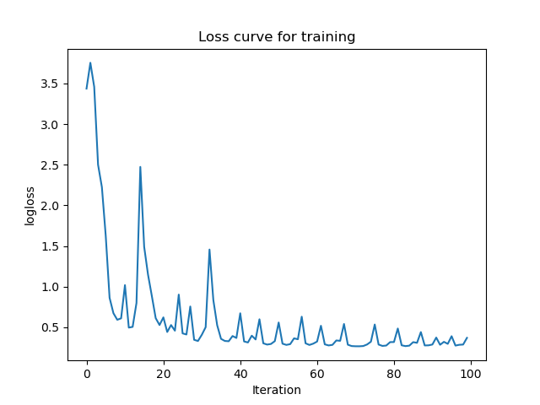
1st iteration using random weights and bias
100th iteration
accuracy: 0.22381496287835523
precision 0.13459407037960655
recall 0.6389345609996712
[[ 1976 12493]
[ 1098 1943]]
accuracy: 0.8932038834951457
precision 0.8106100795755968
recall 0.5024662939822426
[[14112 357]
[ 1513 1528]]
Conclusion: It learned, though a bit roughly

